Slide 1




PROJECT TITLE
Research and demonstrate container-based images on SDN.
TEAM MEMBERS:
Aditi Pandya - N01579827
Anjali Prajapati - N01579923
Dhara Barot - N01559954
Venkata Narasimha Vedavyas - N0158367

Slide 2



Agenda
KEY TOPICS DISCUSSED IN THIS PRESENTATION
Introduction to Snowflake Topology Different types of sdn images

Slide 3
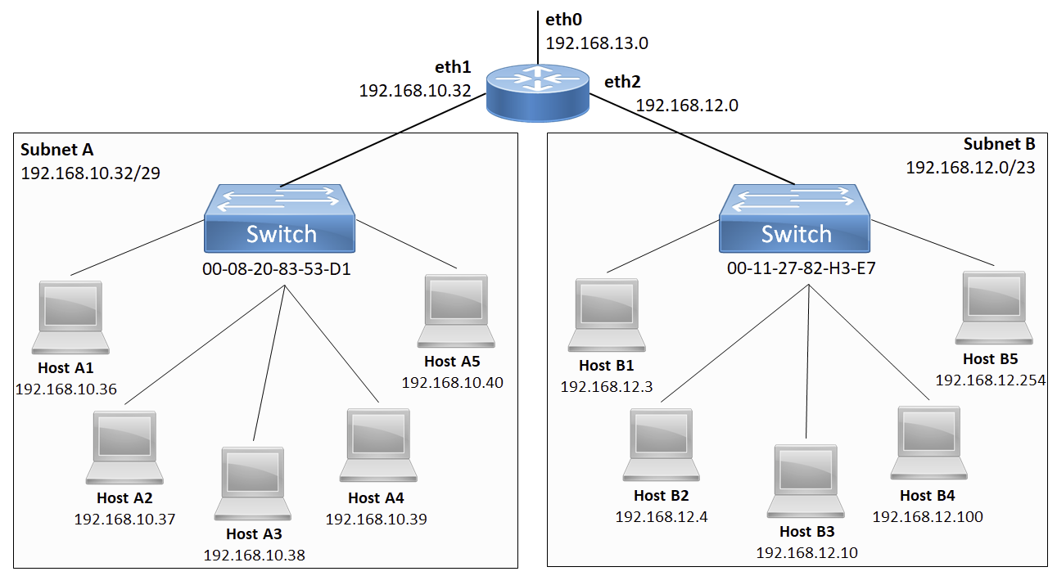

Slide 4

Snowflake Topology
WHAT IS SNOWFLAKE TOPOLOGY ARCHITECTURE?
Snowflake uses a multi-cluster shared data architecture, which means that multiple clusters of compute resources can access the same data stored in the cloud-based object store. This architecture allows for the parallel processing of data and efficient use of computing resources, enabling Snowflake to handle large workloads and support multiple concurrent users.
The topology of Snowflake's architecture is based on three main components: virtual warehouses, virtual private clouds (VPCs), and availability zones.
Availability zones are physically separate data centers within a cloud region that provide redundancy and fault tolerance. Snowflake can be configured to use multiple availability zones within a region to ensure that data is always available, even in the event of a failure in one of the data centers.
Snowflake's topology also includes a range of other features and components, such as load balancers, caching, and routing, which work together to provide high-performance, reliable data processing and analysis in the cloud.

Slide 5
Different SDN Images
Open vSwitch (OVS): OVS is a popular open-source virtual switch that provides high-performance, multi-layer switching with support for SDN protocols such as OpenFlow. It can be run as a containerized image in SDN environments to enable flexible network virtualization and programmable network control.
Docker-SDN: Docker-SDN is a container networking solution provided by Docker, which is a widely used containerization platform. It offers networking features such as multi-host networking, network isolation, and overlay networking, making it suitable for SDN deployments.
Calico: Calico is an open-source networking and network security solution for containers and virtual machines. It provides scalable, secure, and policy-driven networking for container-based applications. Calico can be deployed as a containerized image in SDN environments to enable advanced networking capabilities.
Weave: Weave is a popular open-source container networking solution that provides a simple and secure way to connect containers across different hosts. It supports network segmentation, encryption, and DNS-based service discovery, making it suitable for SDN deployments.
Cilium: Cilium is a modern, API-aware networking and security project that provides enhanced networking features for containers and microservices. It offers advanced networking capabilities such as load balancing, API-aware network security, and service discovery, making it suitable for SDN environments.
Flannel: Flannel is an open-source networking solution that provides a simple and lightweight way to create overlay networks for containers. It uses various backends such as VXLAN, GRE, and host-gw to enable communication between containers running on different hosts, making it suitable for SDN deployments.

Slide 6

THANK YOU

